Slide 1
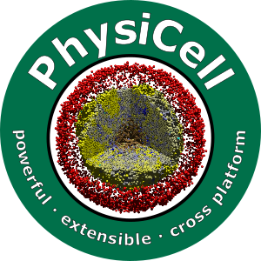

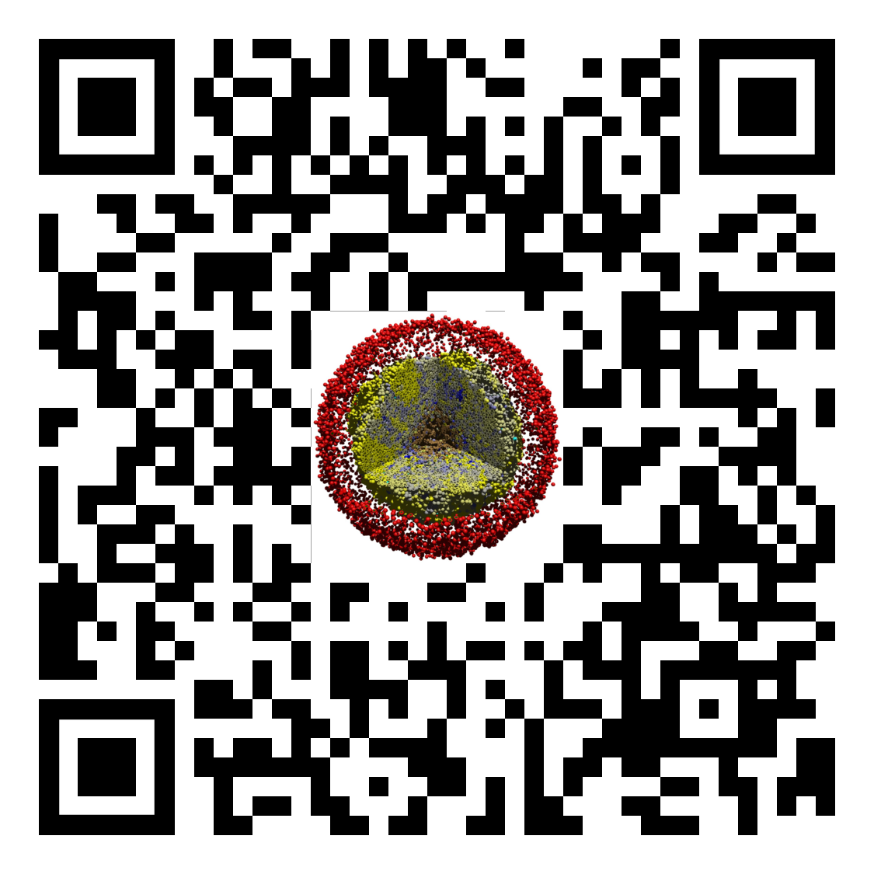
Lesson 08.01: Motility Training
Slides, videos, links and more:
https://github.com/physicell-training/02-How-to-nanoHUB
Paul Macklin, Ph.D.
@MathCancer
last updated: December 12, 2019

Slide 2
Context
Cells
Global Variables
Substrates
Boundary Conditions
Custom Data
List of cells
Cell Functions
Domain Size
User Parameters
PhysiCell Constants
SVG options
MultiCellDS options
Default Cell Definition
Default microenvironment
Voxel Size
Cell State
Basic Agent Variables(inherited)
Cell Definition
Microenvironment
Phenotype

Slide 3
Context
Phenotype
Motility
Cell Cycle
Death
Mechanics
Geometry
Molecular
Volume

Slide 4
Background
Cells move through motility.
Mathematically modeled as a biased Random walk.
No bias : Brownian Motion
Cells move randomly due to their collisions
Yellow Particle
With bias : Random Biased Motion
Cells select movement directions according to some rules
e.g Chemotaxis
“Brownian Motion and Random Walks.” MIT, web.mit.edu/8.334/www/grades/projects/projects17/OscarMickelin/brownian.html.

Slide 5
Mathematics: Variables and Definitions
Migration speed: Migration speed is the speed at which the cells move in μm/min.
Migration bias direction: Preferred migration direction
Migration bias: Impacts the direction that a cell moves.
0 ➔ Random Walk
1 ➔ Deterministic Motion along migration bias direction
(Mean) persistence time: The mean duration in minutes that a cell moves in its current direction before choosing a new motility vector to follow.

Slide 6
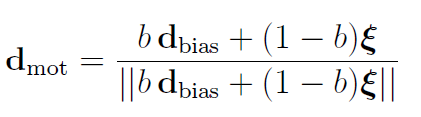
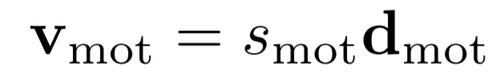
Mathematics: Models
How is motility direction chosen and determines the bias direction?
How is the motility velocity computed?
How often do cells change motility direction?
Where;
d_{mot} : direction of the motility
b: the level of bias in motility (migration bias)
ξ : random unit vector of length 1,
d_{bias} : direction of the bias
Where;
s_{mot}: migration speed
Persistence Time
Notes:
How motility direction is chosen
- Based on the model
- Determine the bias migration angle (directional motility)
How often cells change motility direction
- Depends on persistent time
How motility velocity is computed
Answers should be presented

Slide 7
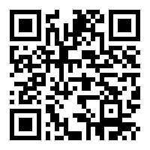
Demonstration
Demo on NanoHUB: https://nanohub.org/tools/trmotility
How to use NanoHUB:
https://github.com/physicell-training/02-How-to-nanoHUB

Slide 8
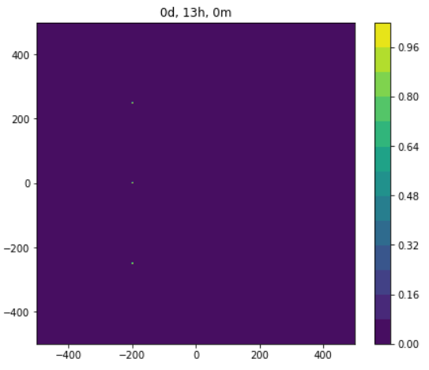
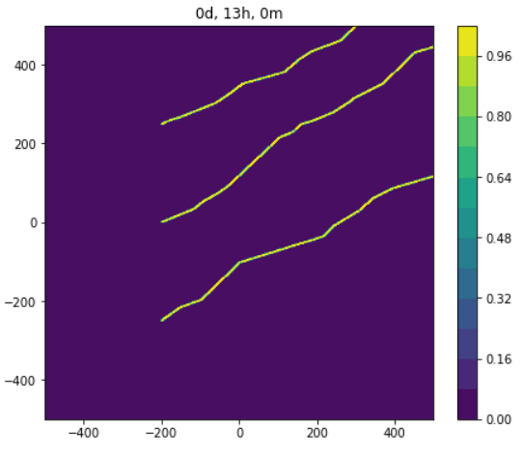
Expected Results (is_motile)
is_motile = False
is_motile = True

Slide 9
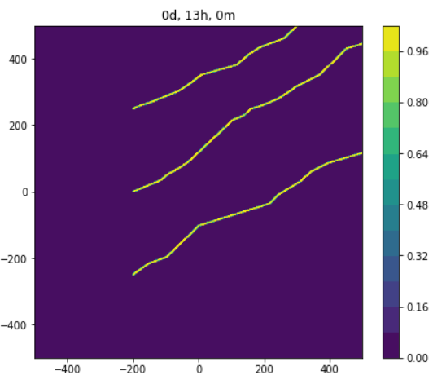
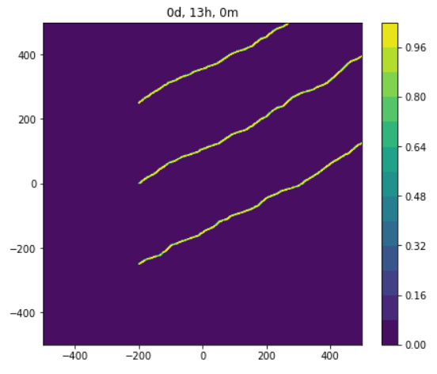
Expected Results (Persistence_time)
persistence_time = 30 min
persistence_time = 5 min

Slide 10
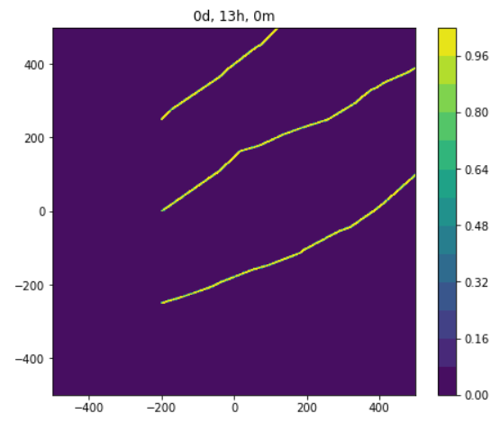
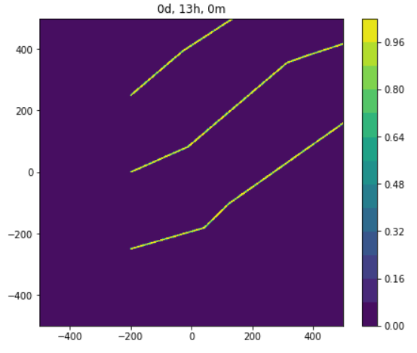
Expected Results (migration_speed)
Migration_speed = 2 micron/min⁻¹
Migration_speed = 10 micron/min⁻¹

Slide 11
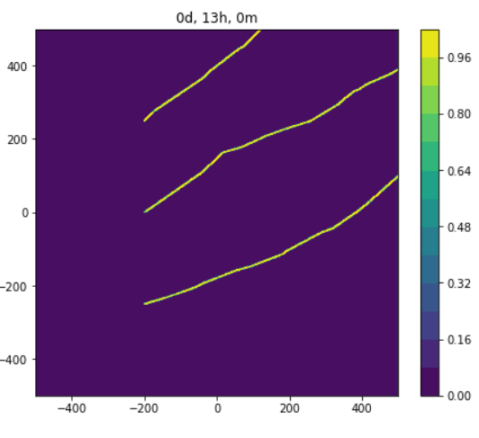
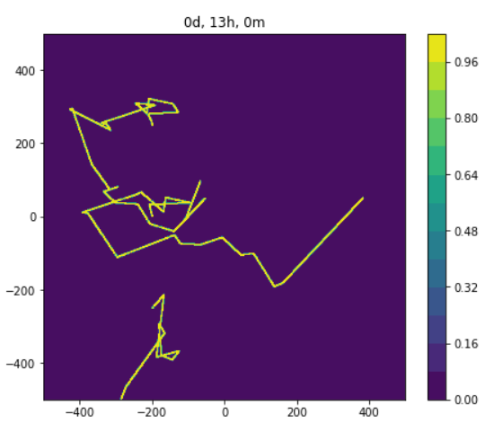
Expected Results (migration_bias)
Migration_bias = 0.8
Migration_bias = 0.2

Slide 12
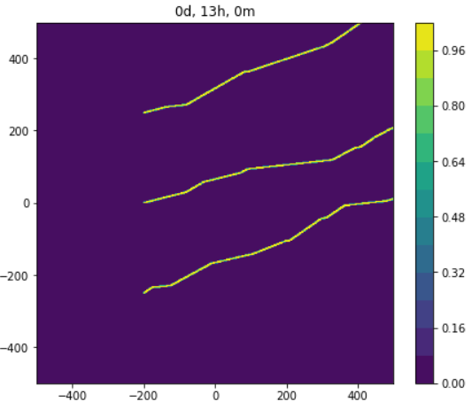
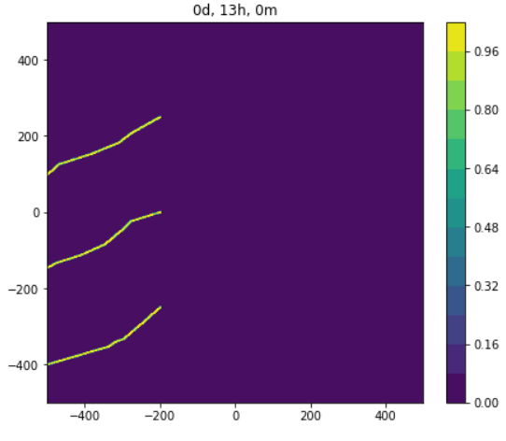
Expected Results (bias_migration_angle)
Migration_bias_angle = 20
Migration_bias_angle = 210

Slide 13
Class structure: Data
Key parameters in phenotype.motility
bool is_motile;
Set to true if cell is / can actively migrate
double persistence_time;
mean time to keep going in one direction before resampling for a new direction.
double migration_speed;
migration speed along chosen direction, in absence of all other adhesive / repulsive forces
std::vector<double> migration_bias_direction;
random motility is biased in this direction (e.g., chemotaxis)
double migration_bias;
how biased is motility
if 0, completely random. if 1, deterministic along the bias vector
bool restrict_to_2D;
Set to true if you want to guarantee 2D motion
std::vector<double> motility_vector;
direction of migration

Slide 14
Example
custom.cpp
Cell* pCell= create_cell();
pCell->phenotype.motility.is_motile= true;
pCell->phenotype.motility.migration_speed= 1.0;
pCell->phenotype.motility.migration.persistence_time= 20;
pCell->phenotype.motility.restrict_to_2D = true;
pCell->phenotype.motility.migration_bias= 0.8;
std::vector<double> temp = { 0.1 , 0.2, 0.0 };
normalize( temp );// makes it’s length 1
pCell->phenotype.motility.migration_bias_direction= temp;

Slide 15
Example
custom.cpp
Cell* pCell= create_cell();
pCell->phenotype.motility.is_motile= parameters.bools( “is_motile" );
pCell->phenotype.motility.migration_speed= parameters.doubles( "migration_speed" );
pCell->phenotype.motility.migration.persistence_time= parameters.doubles(“persistence_time");
pCell->phenotype.motility.restrict_to_2D = true;
pCell->phenotype.motility.migration_bias= parameters.doubles( "migration_bias" );
std::vector<double> temp = { 0.1 , 0.2, 0.0 };
normalize( temp );// makes it’s length 1
pCell->phenotype.motility.migration_bias_direction= temp;
PhysiCell_settings.xml
<is_motile type="bool" units="none" description="true if cells are motile">True</is_motile>
<migration_speed type=“double" units=“micron/min" description=“migration speed">1.0</ migration_speed>
<persistence_time type=“double" units=“min" description=“mean persistence time">1.0</ persistence_time>
<migration_bias type=“double" units=“none" description=“migration bias parameter">0.8</ migration_bias>

Slide 16
Next steps
Super fast: Please proceed to any Lesson 08.x or 09 Link: https://github.com/physicell-training/08.02-phenotype-mechanics
Intermediate: Please proceed to 08.02 (Motility) Link: https://github.com/physicell-training/08.02-phenotype-mechanics
Full training: Please proceed to 08.02 (Motility) Link: https://github.com/physicell-training/08.02-phenotype-mechanics
More materials: https://github.com/physicell-training/master-list

Slide 17




Credits
Lesson Planning: Paul Macklin
Slides: Kali Konstantinopoulos*, Mary Chen*, Furkan Kurtoglu
Recording: Drew Willis
Post-production: Paul Macklin, Drew Willis*, Kali Konstantinopoulos*
Microapps: Furkan Kurtoglu, Paul Macklin
* denotes undergraduate researcher
Funding:
PhysiCell Development:
Breast Cancer Research Foundation
Jayne Koskinas Ted Giovanis Foundation for Health and Policy
National Cancer Institute (U01CA232137)
National Science Foundation (1720625)
Training materials:
* Administrative supplement to NCI U01CA232137 (Year 2)

